Slide 1
Simple Senderer
„Simplicity is the essence of happiness”

Slide 2
My project
This project allows to simply clean your phone out of old photos. Imagine that you have only a few free MB of space and one of your most important application has just got a big update. What would you do? Simply use my application to send your old photos safely to any desktop in the same network. Other use case is to sent just taken photo from your device directly to desktop without wasting your smartphone memory. If you want to know more about my application visit official website simple.senderer.com.

Slide 3

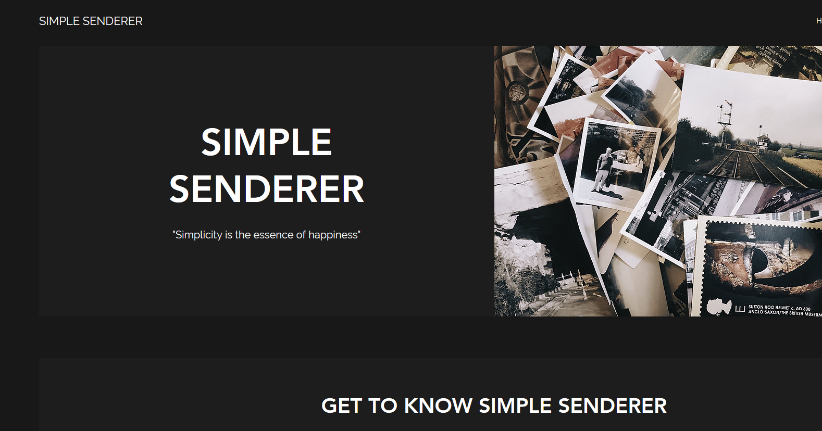
Website
Website includes three main sections:
About – short description what does the application do
Download – contains links for downloading the application on mobile device and desktop version
Contact – allows to send email to suport on dedicated e-mail address

Slide 4
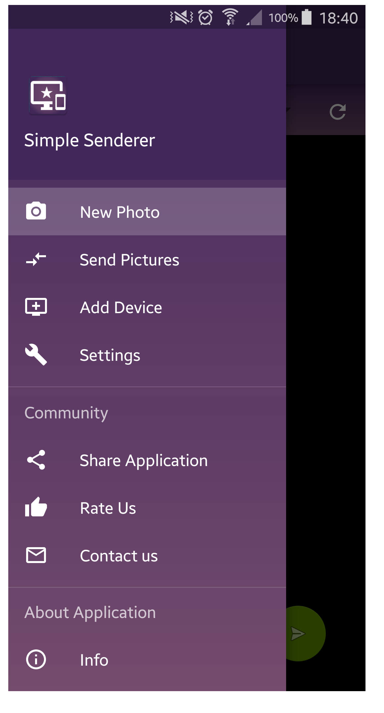
Mobile application
All options of mobile applicaion:
New Photo
Send Pictures
Add Device
Settings
Share Application
Rate Us
Contact Us
Info

Slide 5
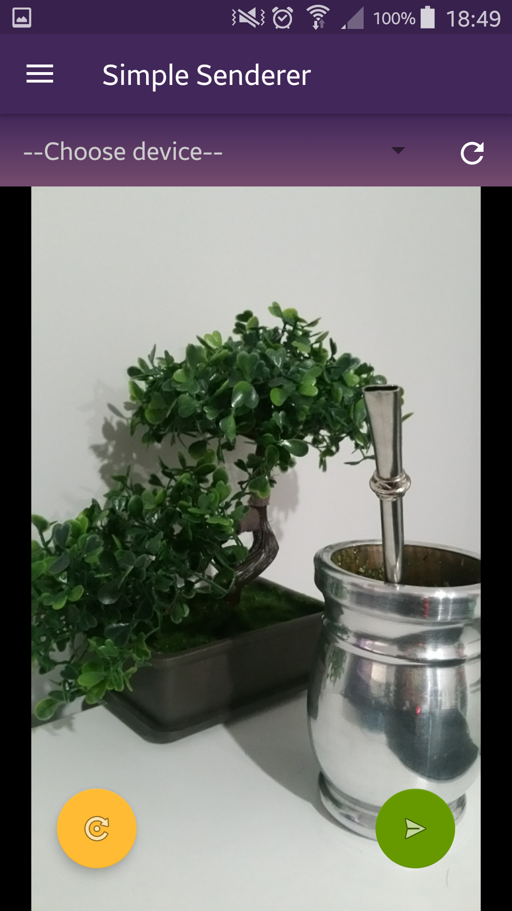
New Photo
Choose device – choose target device from active
Button close to chooser – repeat device searching
Yellow round button – retake photo
Green round button – send taken photo to the chosen device

Slide 6
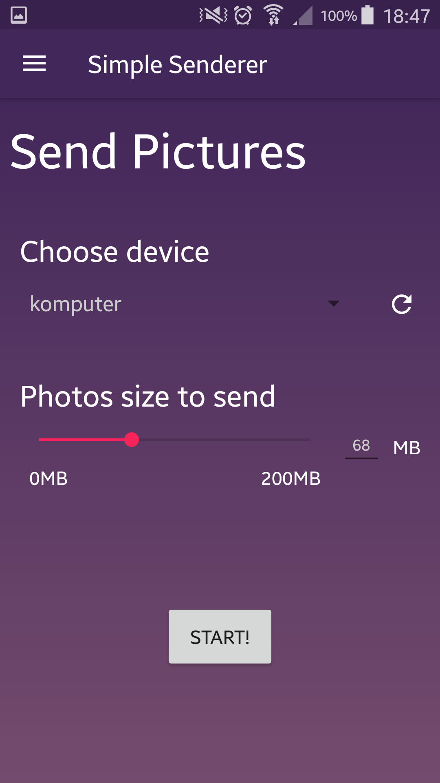
Send Pictures
This fragment allows you to send photos from your device. You simple choose target device (you have options to search devices again), size of photos to send and click start. It’s so simple! You can find more options in settings section.

Slide 7
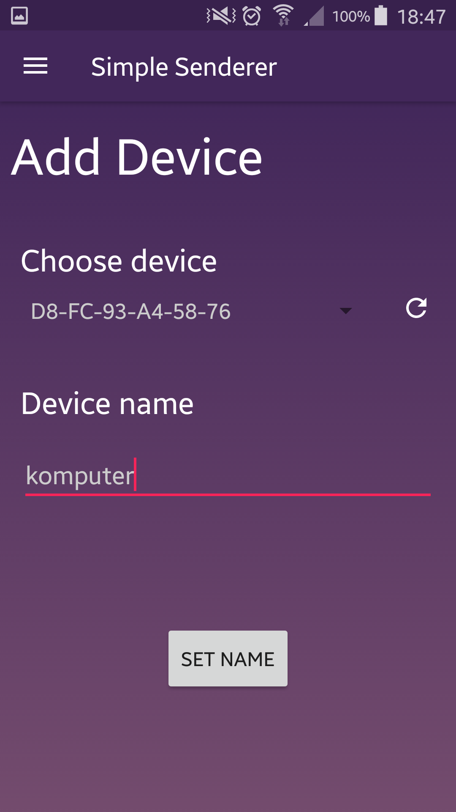
Add Device
Choose device – choose device from the list, if the device has been already added you can see it’s name, if not MAC address
Button close to chooser – repeat device searching
Device name – new name from the device
Button Set name – save device with it’s name in memory

Slide 8
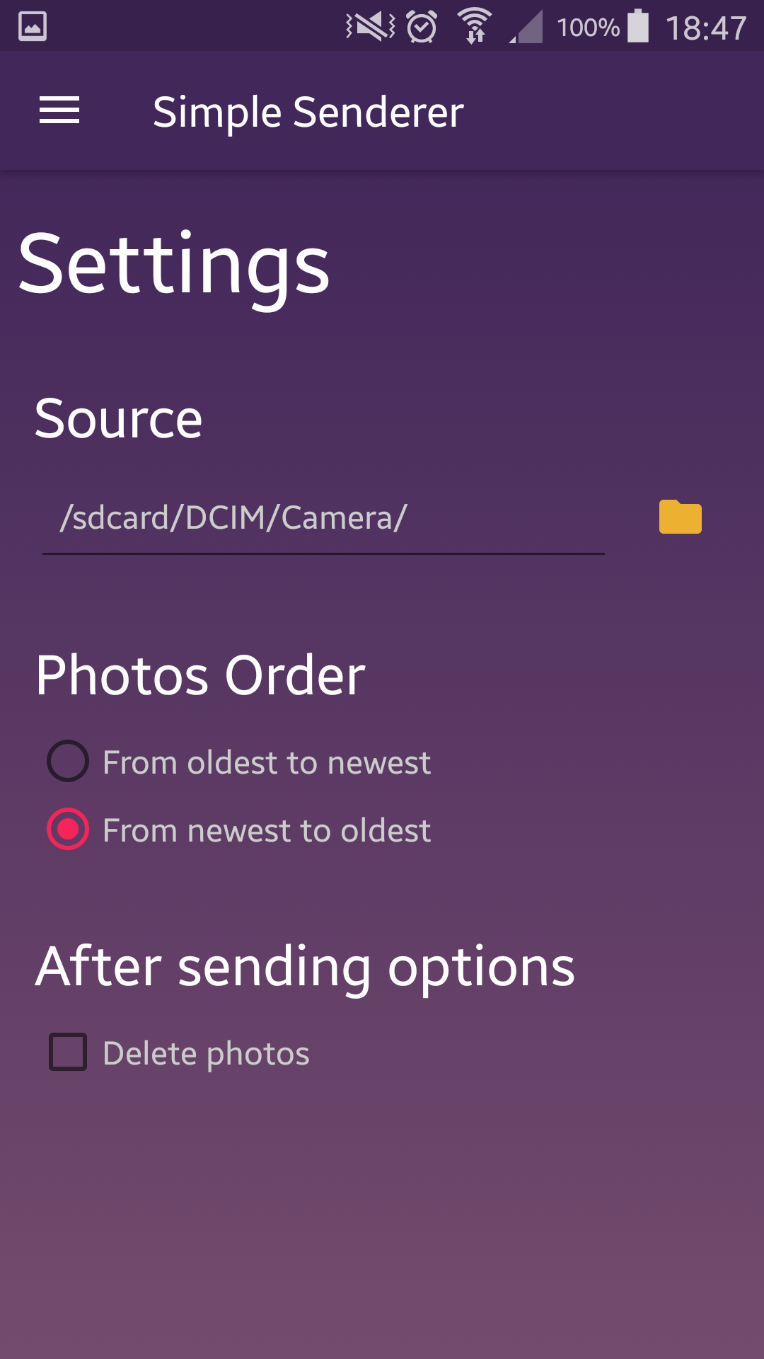
Settings
In settings you can set source folder (from where the photos will be sent), close to it there is a folder picker button. You can choose the order of the photos to sent and if the photos should be deleted after being sent. All options are saved automatically.

Slide 9
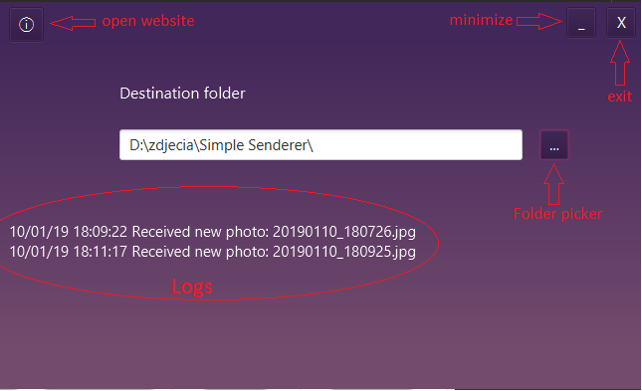
Desktop application
This application receive photos from mobile device. You can choose a destination folder for your photos. Logs allows yout to see what photos and when were sent. If you want to find out more about this application, info button in the top-left corner will open our website in your default browser.

Slide 10
New skills
It was my first application on mobile device, first application using network connection and finally first such a big project. I’ve learnt a lot, for example:
Creating fragments and operating with them
Working with database on mobile device
Working with several intents (new photo intent, email sending, opening website in browser..)
Keeping data in SharedPreferences
Multicasting, broadcasting and unicast
Preparing interface for user

Slide 11
Bright and dark sides of the project
This was a very time consuming project. All the time I had (and have) feeling that there is something to add, change or make looks better. I have a lot troubles while coding. The biggest one was I believe in searching active devices in LAN via WiFi. After a lot of ideas I decided to use multicasting which is, I believe, best solutions for it. Now, having this all skills, I would definitely choose more complicated application using for example GPS, accelerometer and gyroscope or other features which are offered by mobile devices. As a conclusion, It was great project to learn some basics of mobile devices programming.

Slide 12
Thank you for your attention.
Do you have any questions?

